Slide 1
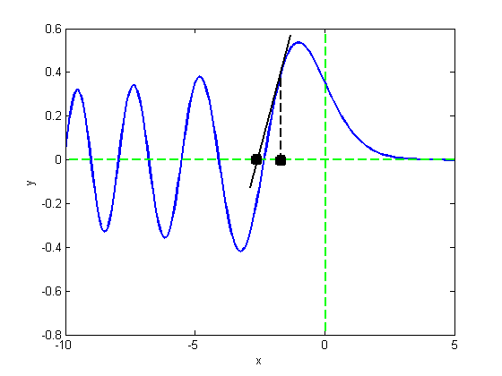
Chapter 4
Rootfinding

Slide 2
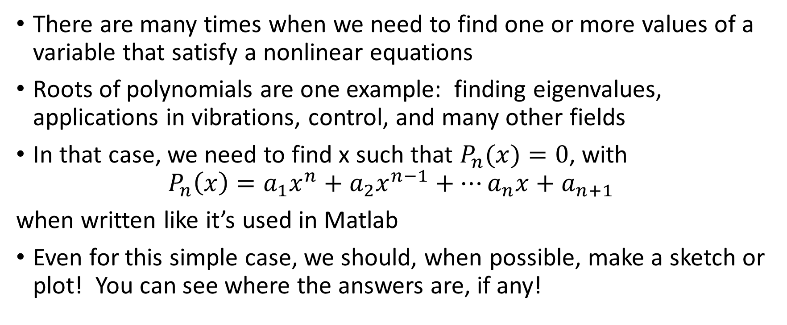
The root finding problem
There are many times when we need to find one or more values of a variable that satisfy a nonlinear equations
Roots of polynomials are one example: finding eigenvalues, applications in vibrations, control, and many other fields
In that case, we need to find x such that $P_{n}(x)=0$, with
$$P_{n}\left(x\right)=a_{1}x^{n}+a_{2}x^{n−1}+…a_{n}x+a_{n+1}$$
when written like it’s used in Matlab
Even for this simple case, we should, when possible, make a sketch or plot! You can see where the answers are, if any!

Slide 3
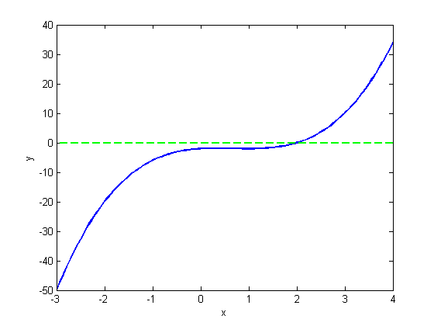
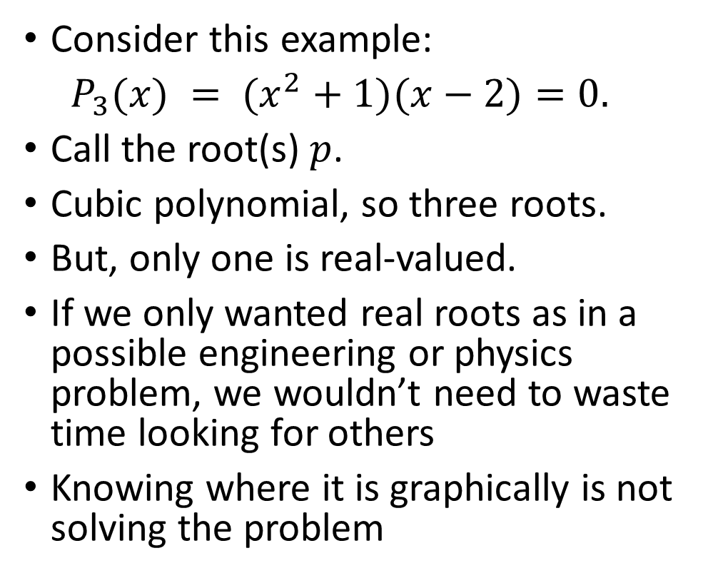
The root finding problem
Consider this example:
$P_{3}(x) = (x^{2}+1)(x−2)=0.$
Call the root(s) $p$.
Cubic polynomial, so three roots.
But, only one is real-valued.
If we only wanted real roots as in a possible engineering or physics problem, we wouldn’t need to waste time looking for others
Knowing where it is graphically is not solving the problem

Slide 4
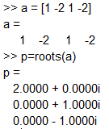
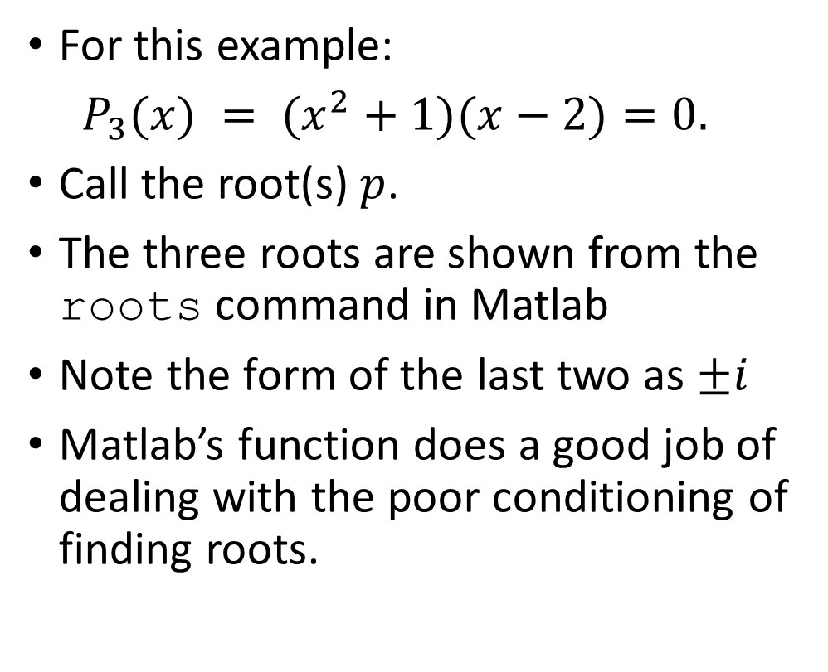
The root finding problem
For this example:
$P_{3}(x) = (x^{2}+1)(x−2)=0.$
Call the root(s) $p$.
The three roots are shown from the roots command in Matlab
Note the form of the last two as $±i$
Matlab’s function does a good job of dealing with the poor conditioning of finding roots.

Slide 5
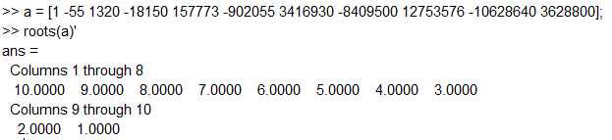
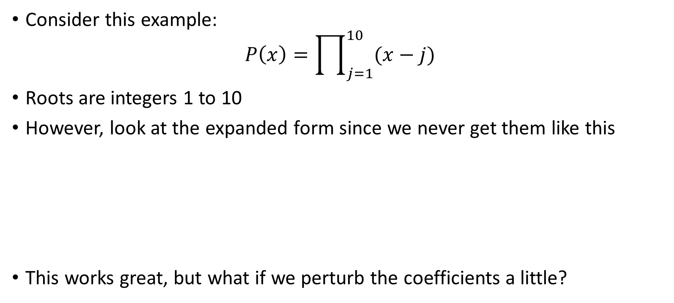
The root finding problem
Consider this example:
$$P\left(x\right)=\prod_{j=1}^{10}{(x−j)}$$
Roots are integers 1 to 10
However, look at the expanded form since we never get them like this
This works great, but what if we perturb the coefficients a little?

Slide 6
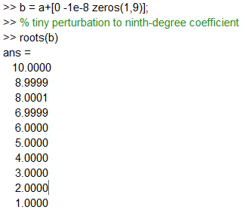
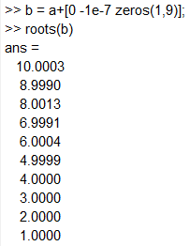
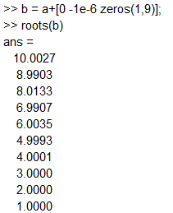

The root finding problem
Now modify the 9th degree coefficient a tiny bit ($a_{2}=−55$)
What happens?
You try it. Keep increasing the perturbation
If uncertainty/noice in coefficients, use with caution!

Slide 7
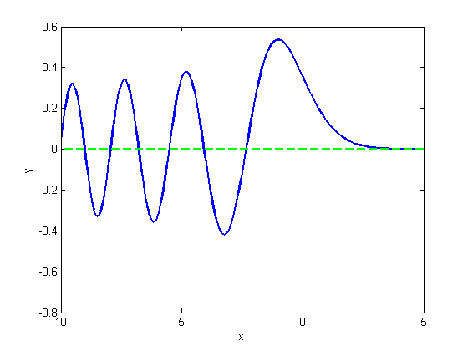
The root finding problem
There are lots of different functions that have zeros
So-called “special functions” are solutions to variable coefficient ODE problems that arise typically from PDE problems
Text example of Bessel function arises from vibration of circular drum head
Another example is Airy function Ai(x) that satisfies y’’-xy=0.
Can you see why one side oscillates?

Slide 8
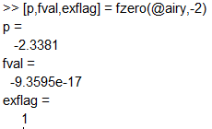
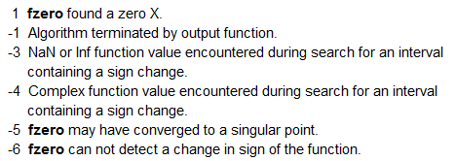
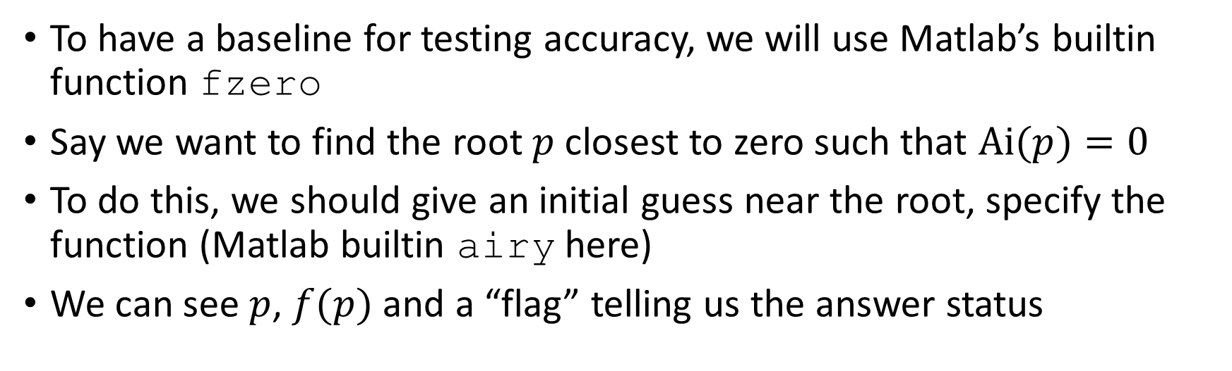
The root finding problem
To have a baseline for testing accuracy, we will use Matlab’s builtin function fzero
Say we want to find the root $p$ closest to zero such that $Ai(p)=0$
To do this, we should give an initial guess near the root, specify the function (Matlab builtin airy here)
We can see $p$, $f(p)$ and a “flag” telling us the answer status

Slide 9
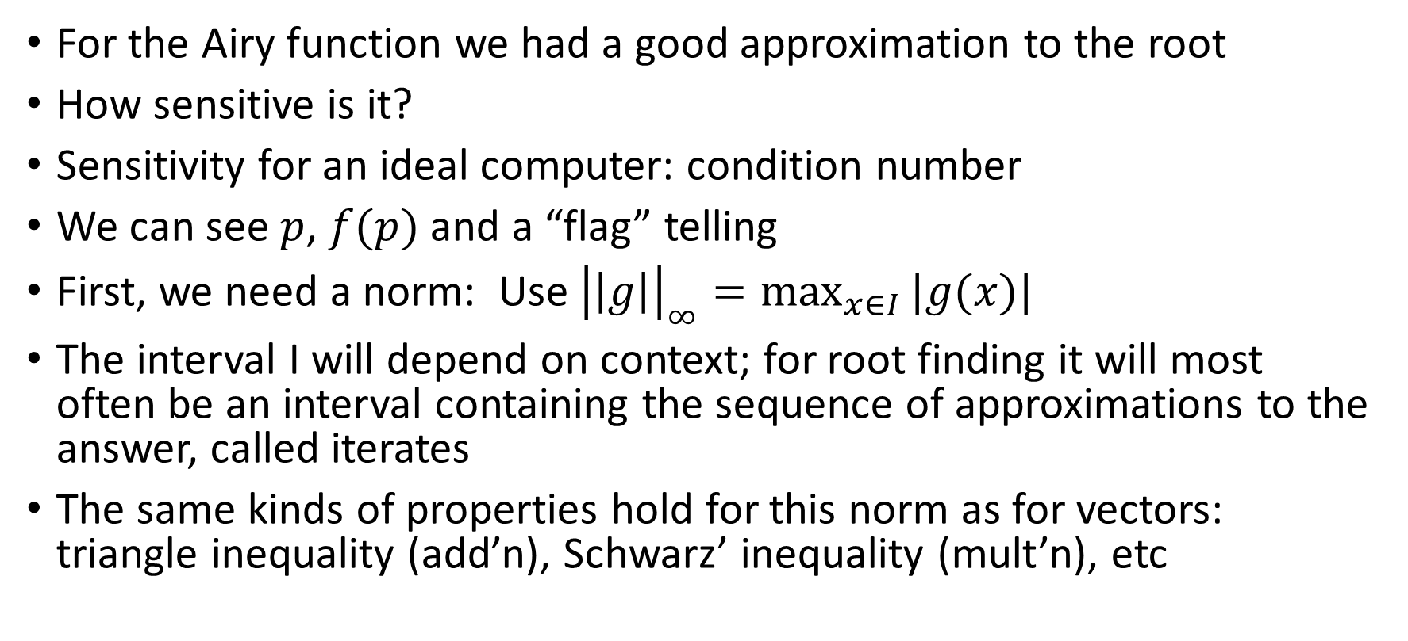
The root finding problem
For the Airy function we had a good approximation to the root
How sensitive is it?
Sensitivity for an ideal computer: condition number
We can see $p$, $f(p)$ and a “flag” telling
First, we need a norm: Use ${\left|\left|g\right|\right|}_{∞}=\max_{x∈I}{|g(x)|}$
The interval I will depend on context; for root finding it will most often be an interval containing the sequence of approximations to the answer, called iterates
The same kinds of properties hold for this norm as for vectors: triangle inequality (add’n), Schwarz’ inequality (mult’n), etc

Slide 10
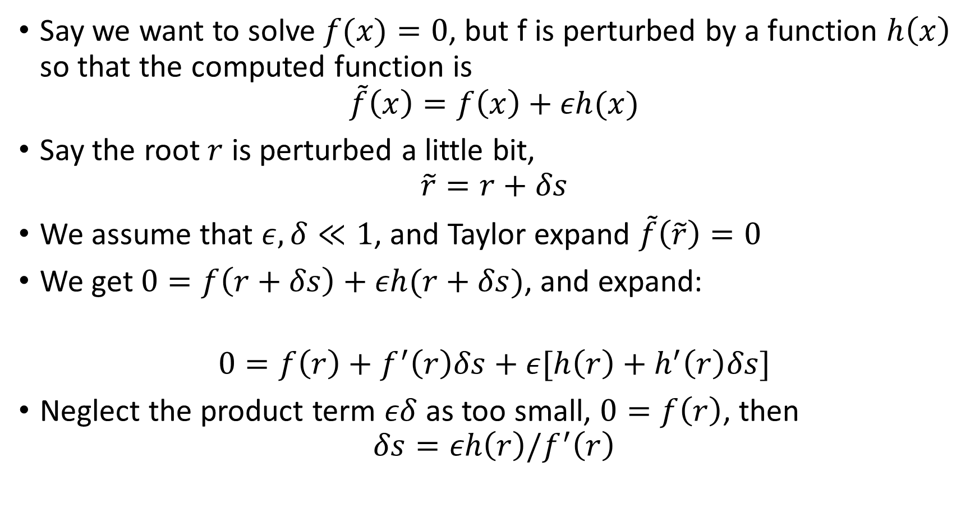
Conditioning of root finding
Say we want to solve $f(x)=0$, but f is perturbed by a function $h\left(x\right)$ so that the computed function is
$$\tilde{f}\left(x\right)=f\left(x\right)+εh(x)$$
Say the root $r$ is perturbed a little bit,
$$\tilde{r}=r+δs$$
We assume that $ε, δ≪1$, and Taylor expand $\tilde{f}\left(\tilde{r}\right)=0$
We get $0=f\left(r+δs\right)+εh(r+δs)$, and expand:
$$0=f\left(r\right)+f^{′}\left(r\right)δs+ε[h\left(r\right)+h^{′}\left(r\right)δs]$$
Neglect the product term $εδ$ as too small, $0=f\left(r\right)$, then
$$δs=εh\left(r\right)/f^{′}\left(r\right)$$

Slide 11
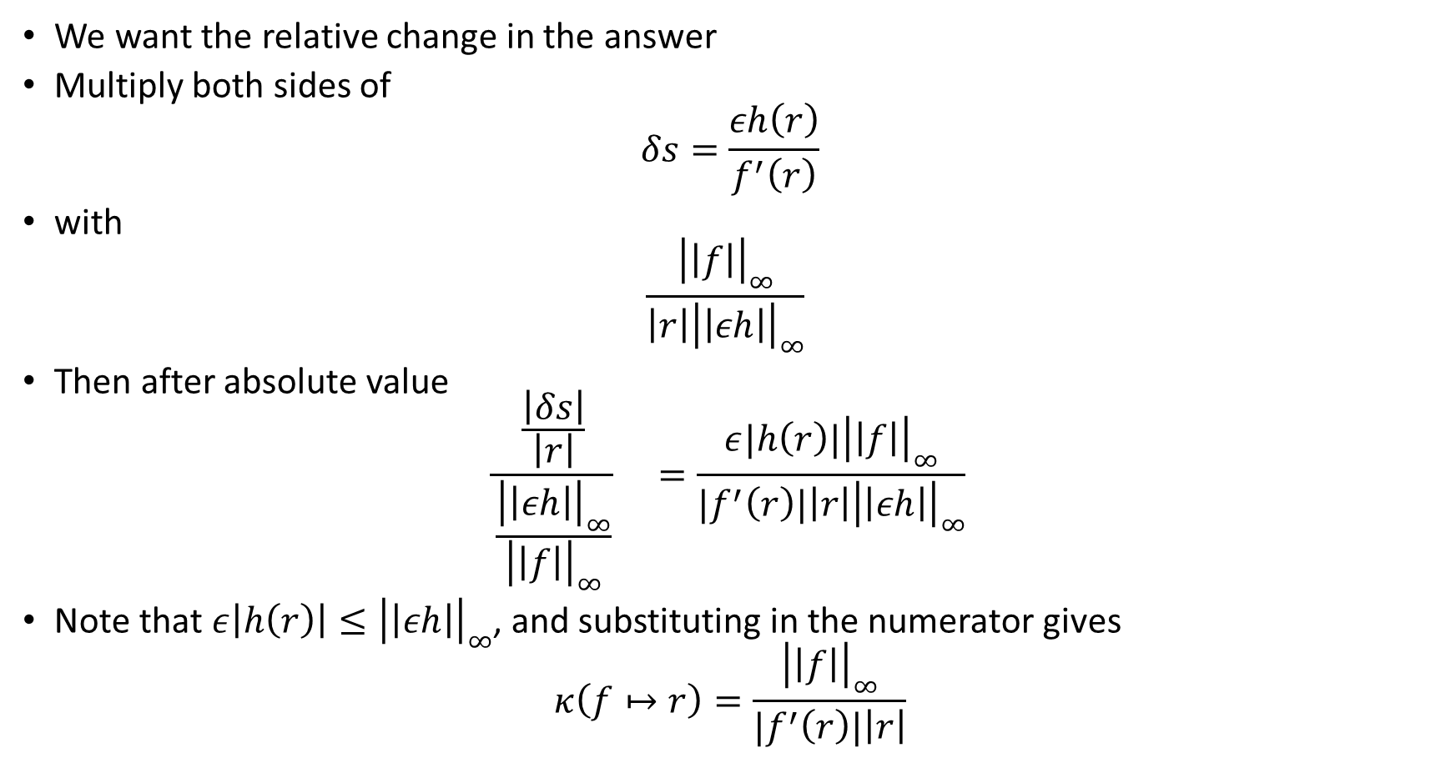
Conditioning of root finding
We want the relative change in the answer
Multiply both sides of
$$δs=\frac{εh\left(r\right)}{f^{′}\left(r\right)}$$
with
$$\frac{{\left|\left|f\right|\right|}_{∞}}{\left|r\right|{\left|\left|εh\right|\right|}_{∞}}$$
Then after absolute value
$$\frac{\frac{\left|δs\right|}{\left|r\right|}}{\frac{{\left|\left|εh\right|\right|}_{∞}}{{\left|\left|f\right|\right|}_{∞}}} =\frac{ε|h\left(r\right)|{\left|\left|f\right|\right|}_{∞}}{{|f}^{′}\left(r\right)|\left|r\right|{\left|\left|εh\right|\right|}_{∞}}$$
Note that $ε\left|h\left(r\right)\right|≤{\left|\left|εh\right|\right|}_{∞}$, and substituting in the numerator gives
$$κ\left(f↦r\right)=\frac{{\left|\left|f\right|\right|}_{∞}}{{|f}^{′}\left(r\right)|\left|r\right|}$$

Slide 12
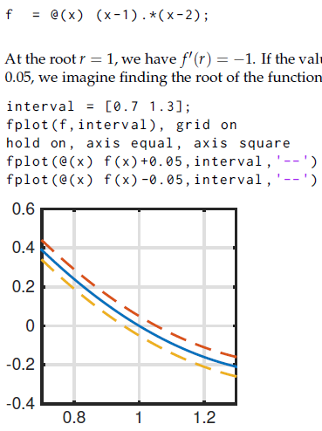
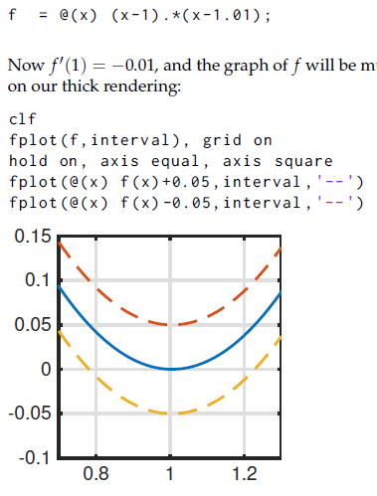
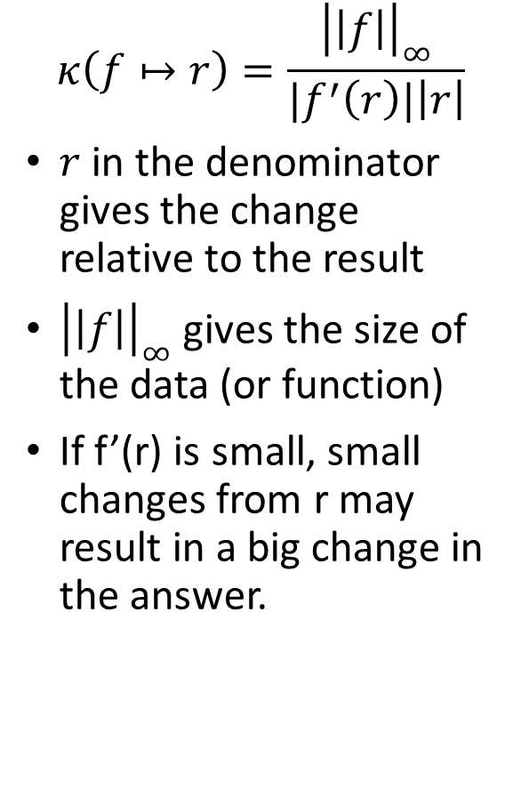
Conditioning of root finding
$$κ\left(f↦r\right)=\frac{{\left|\left|f\right|\right|}_{∞}}{{|f}^{′}\left(r\right)|\left|r\right|}$$
$r$ in the denominator gives the change relative to the result
${\left|\left|f\right|\right|}_{∞}$ gives the size of the data (or function)
If f’(r) is small, small changes from r may result in a big change in the answer.

Slide 13
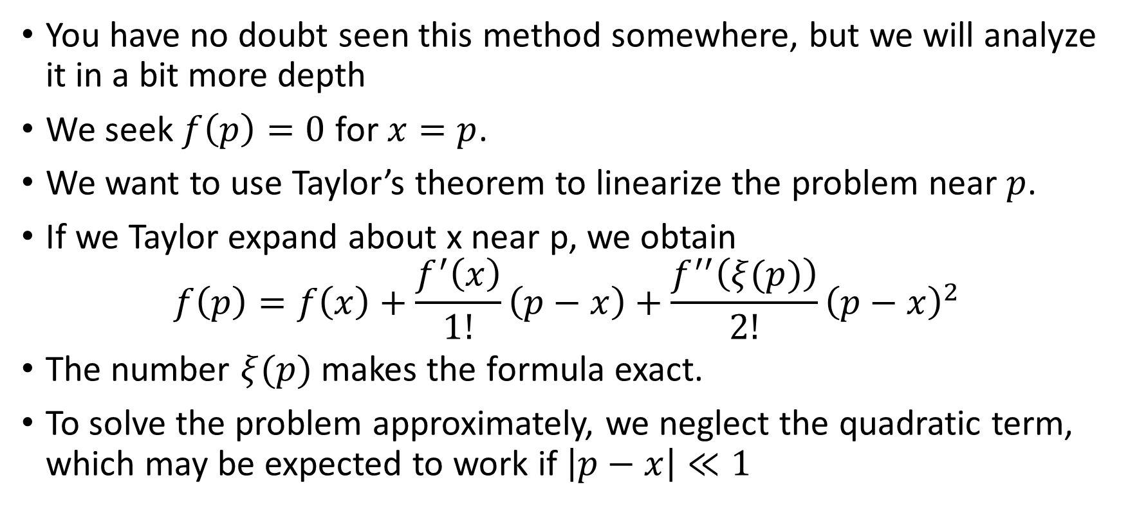
Root finding: Newton’s method
You have no doubt seen this method somewhere, but we will analyze it in a bit more depth
We seek $f\left(p\right)=0$ for $x=p$.
We want to use Taylor’s theorem to linearize the problem near $p$.
If we Taylor expand about x near p, we obtain
$$f\left(p\right)=f\left(x\right)+\frac{f^{′}\left(x\right)}{1!}\left(p−x\right)+\frac{f^{′′}\left(ξ(p)\right)}{2!}{\left(p−x\right)}^{2}$$
The number $ξ(p)$ makes the formula exact.
To solve the problem approximately, we neglect the quadratic term, which may be expected to work if $\left|p−x\right|≪1$

Slide 14
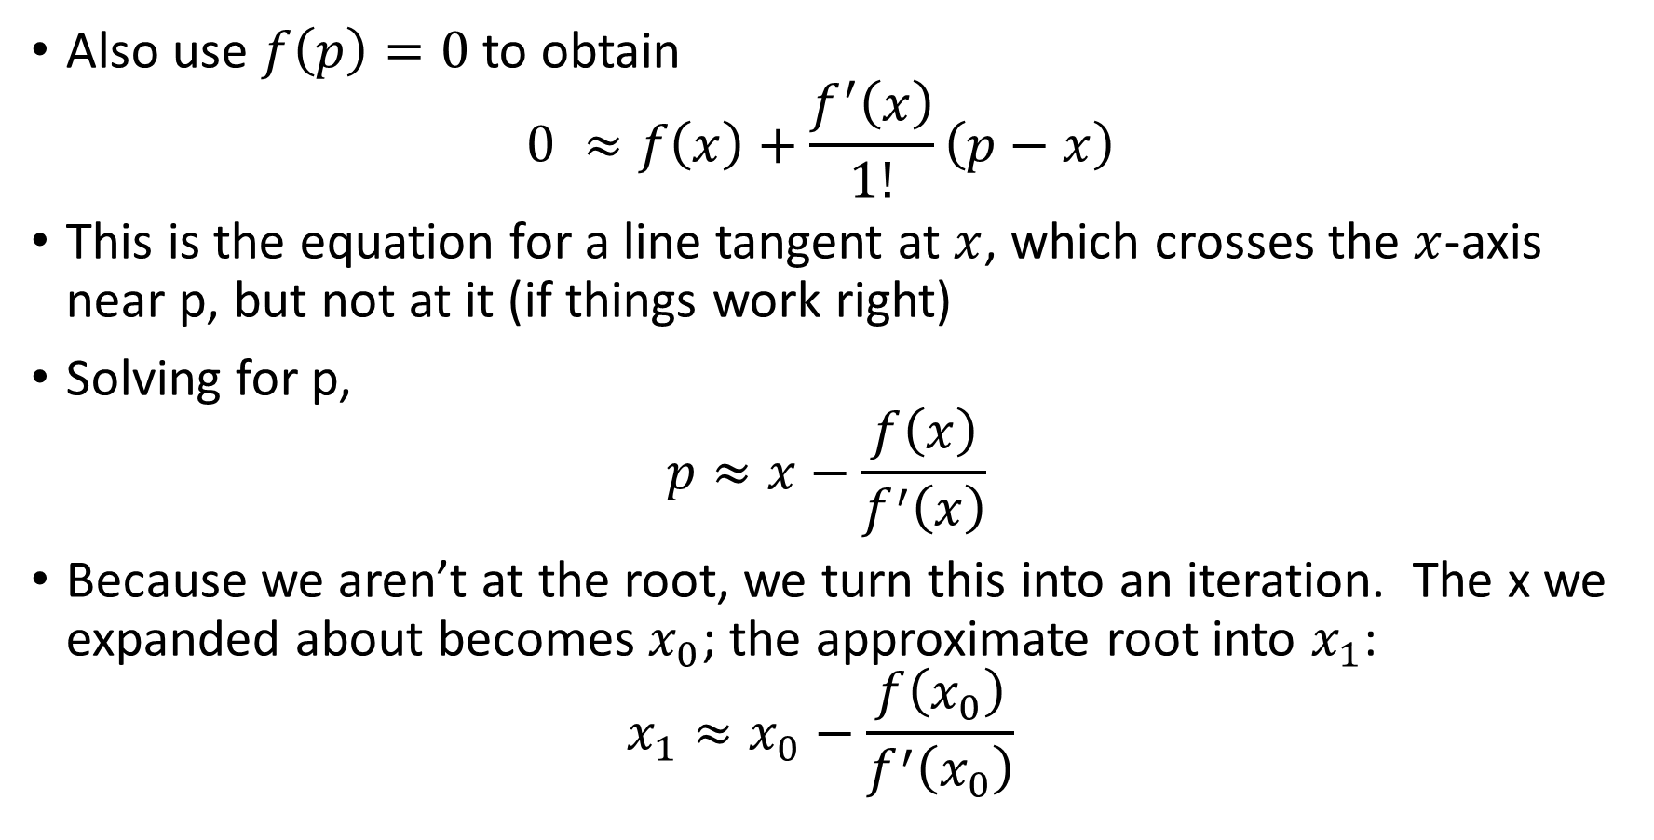
Root finding: Newton’s method
Also use $f\left(p\right)=0$ to obtain
$$0 ≈f\left(x\right)+\frac{f^{′}\left(x\right)}{1!}\left(p−x\right)$$
This is the equation for a line tangent at $x$, which crosses the $x$-axis near p, but not at it (if things work right)
Solving for p,
$$p≈x−\frac{f\left(x\right)}{f^{′}\left(x\right)}$$
Because we aren’t at the root, we turn this into an iteration. The x we expanded about becomes $x_{0}$; the approximate root into $x_{1}$:
$$x_{1}≈x_{0}−\frac{f\left(x_{0}\right)}{f^{′}\left(x_{0}\right)}$$

Slide 15
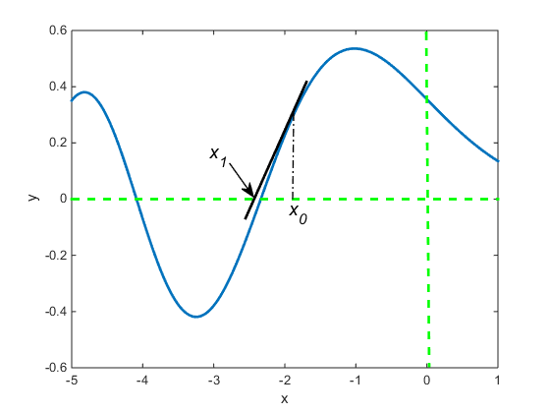

Root finding: Newton’s method
$x_{1}$ is an approximation as well.
Using it on the right side, we can generate a new approximation.

Slide 16
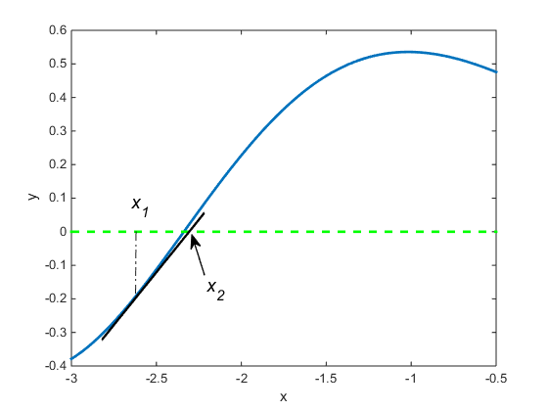
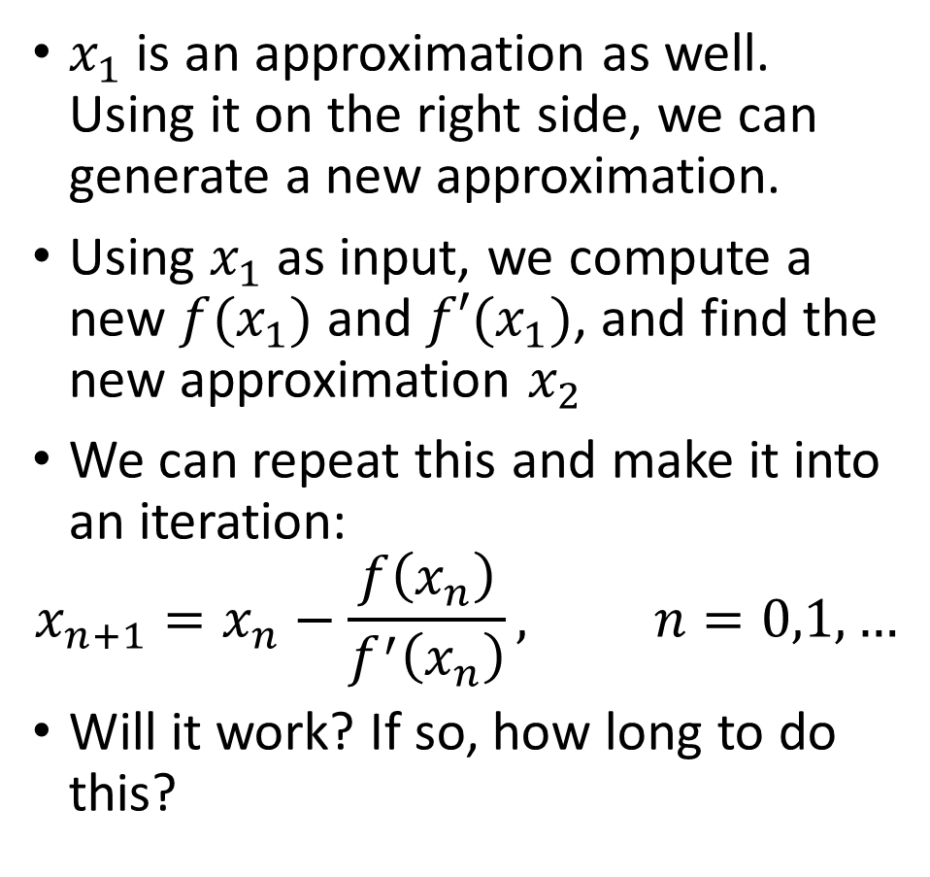
Root finding: Newton’s method
$x_{1}$ is an approximation as well. Using it on the right side, we can generate a new approximation.
Using $x_{1}$ as input, we compute a new $f(x_{1})$ and $f′(x_{1})$, and find the new approximation $x_{2}$
We can repeat this and make it into an iteration:
$$x_{n+1}=x_{n}−\frac{f\left(x_{n}\right)}{f^{′}\left(x_{n}\right)}, n=0,1,…$$
Will it work? If so, how long to do this?

Slide 17

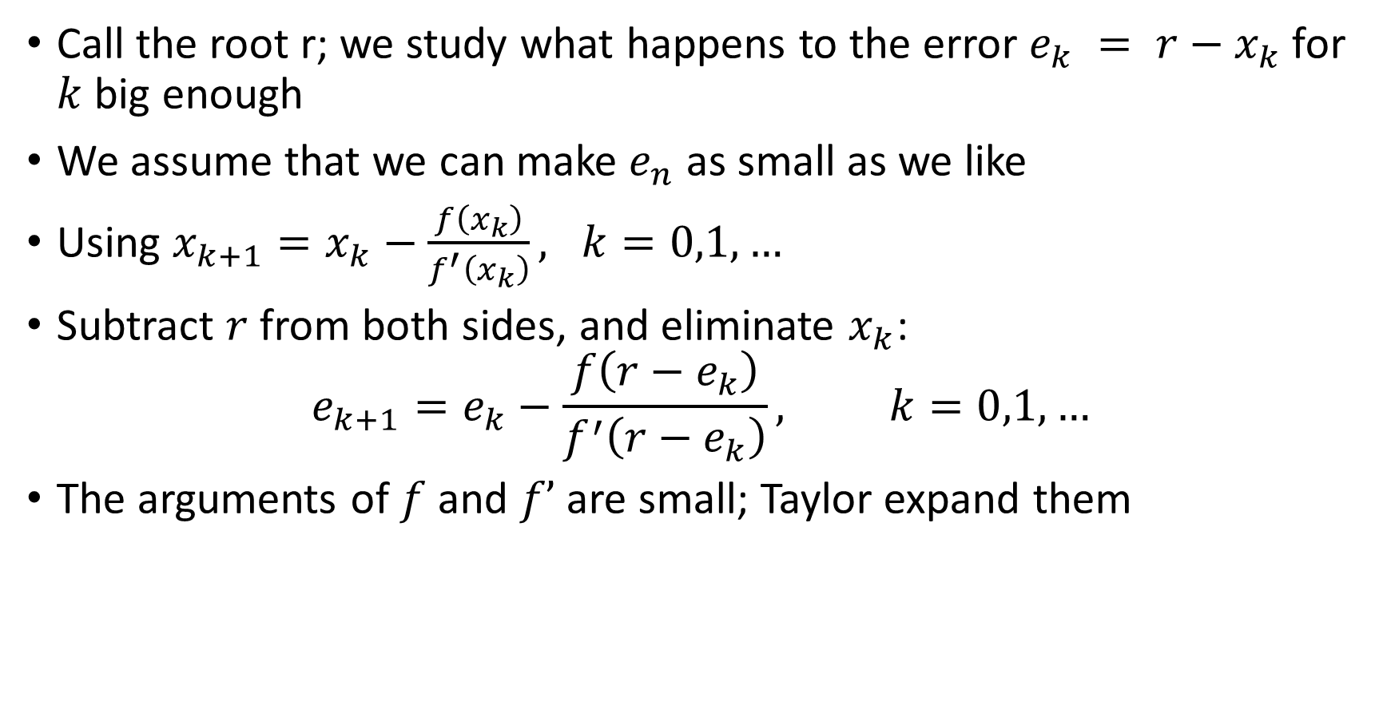
Newton’s method: convergence analysis
Call the root r; we study what happens to the error $e_{k} = r−x_{k}$ for $k$ big enough
We assume that we can make $e_{n}$ as small as we like
Using $x_{k+1}=x_{k}−\frac{f\left(x_{k}\right)}{f^{′}\left(x_{k}\right)}, k=0,1,…$
Subtract $r$ from both sides, and eliminate $x_{k}$:
$$e_{k+1}=e_{k}−\frac{f\left(r−e_{k}\right)}{f^{′}\left(r−e_{k}\right)}, k=0,1,…$$
The arguments of $f$ and $f’$ are small; Taylor expand them

Slide 18

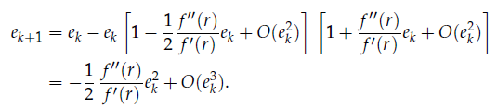
Newton’s method: convergence analysis
Now use f(r)=0 in
Then factor out f’(r); result in denominator can be written as geometric series:
Multiply out the last two terms:

Slide 19
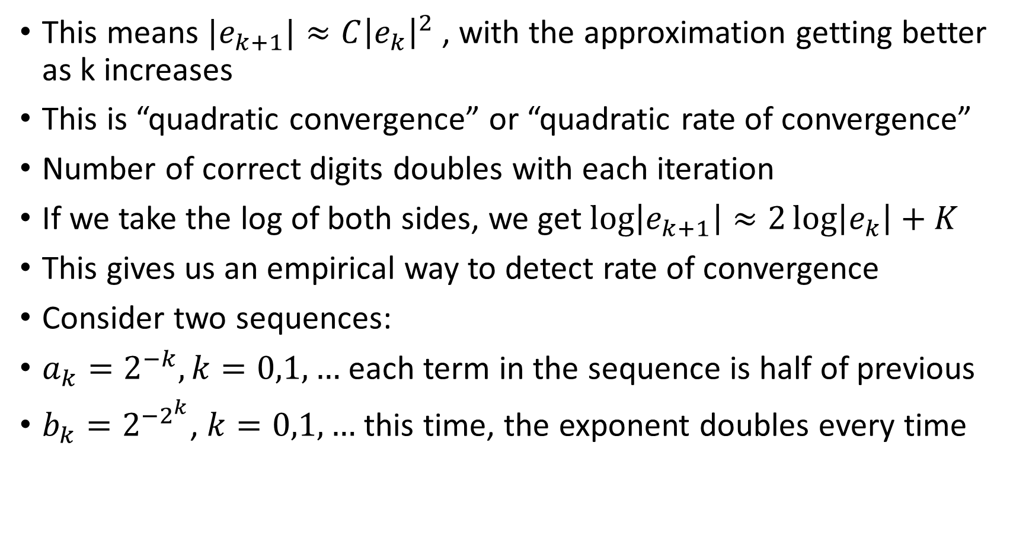
Newton’s method: convergence analysis
This means $|e_{k+1}|≈C{\left|e_{k}\right|}^{2}$, with the approximation getting better as k increases
This is “quadratic convergence” or “quadratic rate of convergence”
Number of correct digits doubles with each iteration
If we take the log of both sides, we get $log\left|e_{k+1}\right|≈2\log\left|e_{k}\right|+K$
This gives us an empirical way to detect rate of convergence
Consider two sequences:
$a_{k}=2^{−k}, k=0,1,…$ each term in the sequence is half of previous
$b_{k}=2^{−2^{k}}$, $k=0,1,…$ this time, the exponent doubles every time

Slide 20
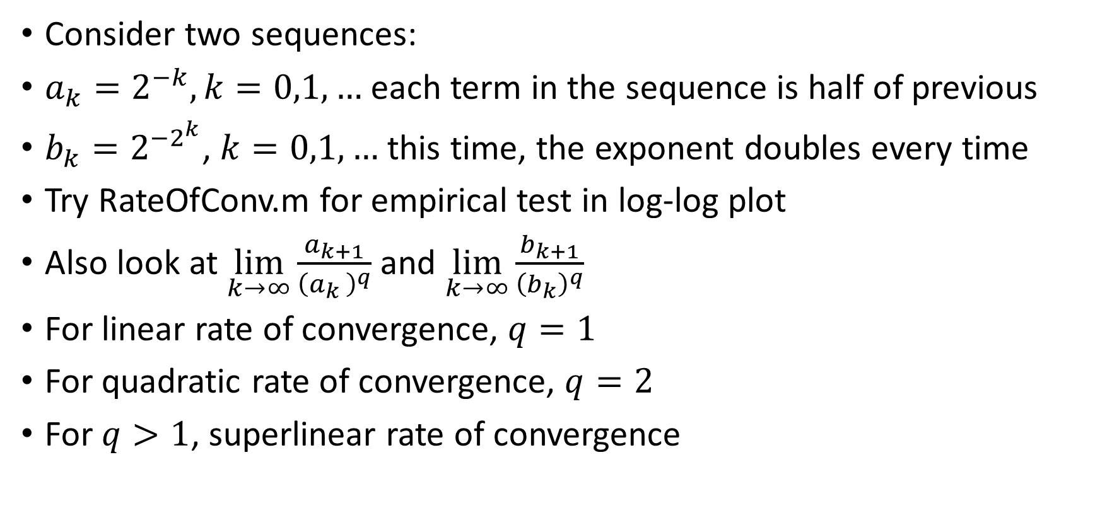
Newton’s method: convergence analysis
Consider two sequences:
$a_{k}=2^{−k}, k=0,1,…$ each term in the sequence is half of previous
$b_{k}=2^{−2^{k}}$, $k=0,1,…$ this time, the exponent doubles every time
Try RateOfConv.m for empirical test in log-log plot
Also look at $\lim_{k→∞}{\frac{a_{k+1}}{{\left(a_{k }\right)}^{q}}}$ and $\lim_{k→∞}{\frac{b_{k+1}}{{\left(b_{k}\right)}^{q}}}$
For linear rate of convergence, $q=1$
For quadratic rate of convergence, $q=2$
For $q>1$, superlinear rate of convergence

Slide 21


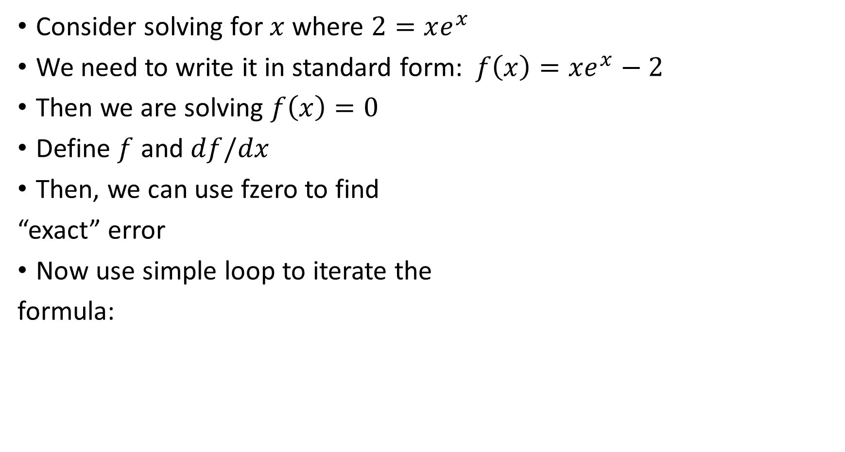
Newton’s method: example
Consider solving for $x$ where $2=xe^{x}$
We need to write it in standard form: $f\left(x\right)=xe^{x}−2$
Then we are solving $f\left(x\right)=0$
Define $f$ and $df/dx$
Then, we can use fzero to find
“exact” error
Now use simple loop to iterate the
formula:

Slide 22
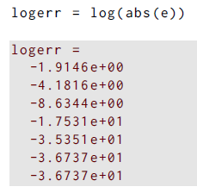
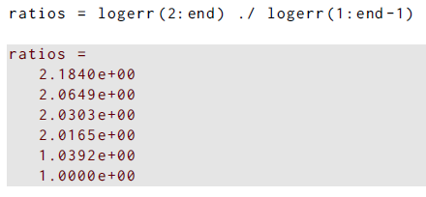
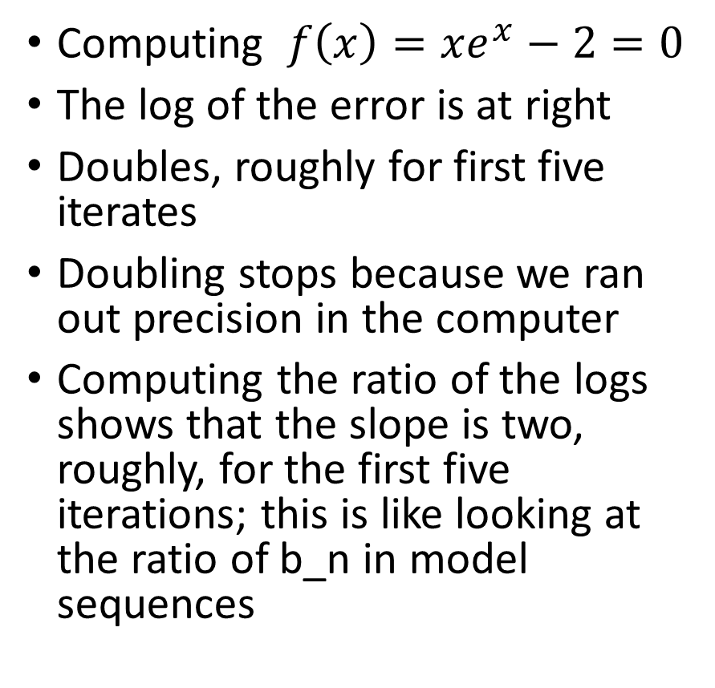
Newton’s method: example
Computing $f\left(x\right)=xe^{x}−2=0$
The log of the error is at right
Doubles, roughly for first five iterates
Doubling stops because we ran out precision in the computer
Computing the ratio of the logs shows that the slope is two, roughly, for the first five iterations; this is like looking at the ratio of b_n in model sequences

Slide 23
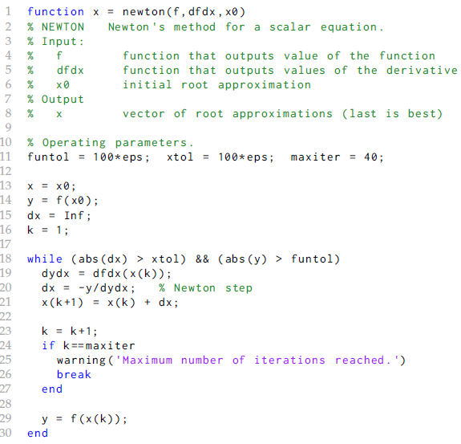
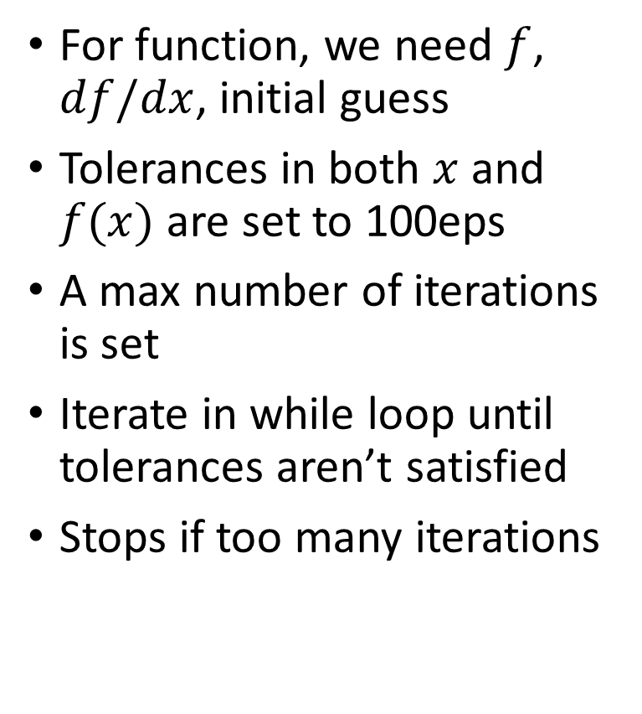
Newton’s method: Code
For function, we need $f$, $df/dx$, initial guess
Tolerances in both $x$ and $f(x)$ are set to 100eps
A max number of iterations is set
Iterate in while loop until tolerances aren’t satisfied
Stops if too many iterations

Slide 24
Newton’s method: observations and advice
If mistakes in df/dx or if multiple roots, then rate of convergence falls to only a linear rate of convergence
If you see linear convergence, check your functions for mistakes, or multiple roots
The guess must be close enough to the root to avoid zero slope in the function and to converge quadratically

Slide 25
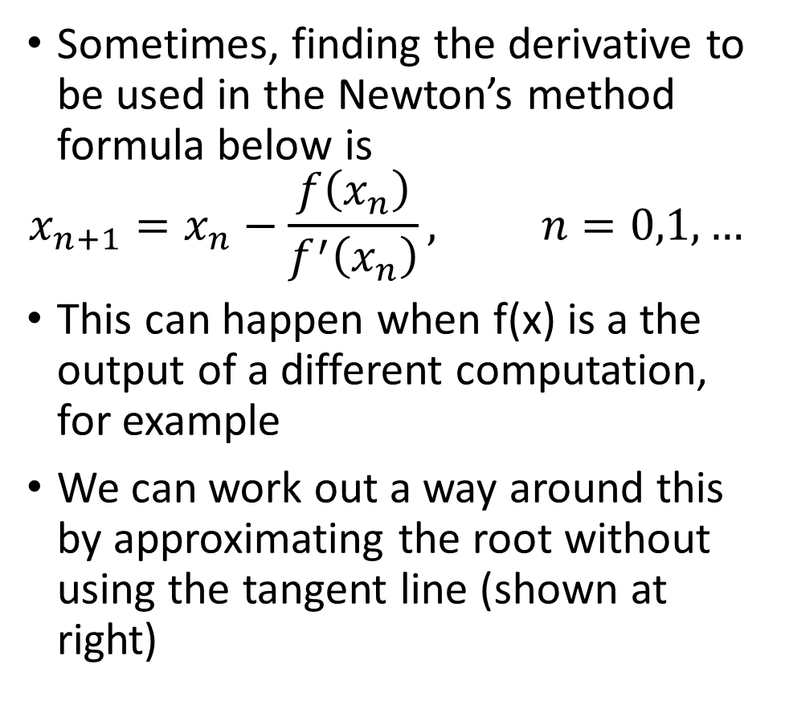
Root finding: Secant method
Sometimes, finding the derivative to be used in the Newton’s method formula below is
$$x_{n+1}=x_{n}−\frac{f\left(x_{n}\right)}{f^{′}\left(x_{n}\right)}, n=0,1,…$$
This can happen when f(x) is a the output of a different computation, for example
We can work out a way around this by approximating the root without using the tangent line (shown at right)

Slide 26
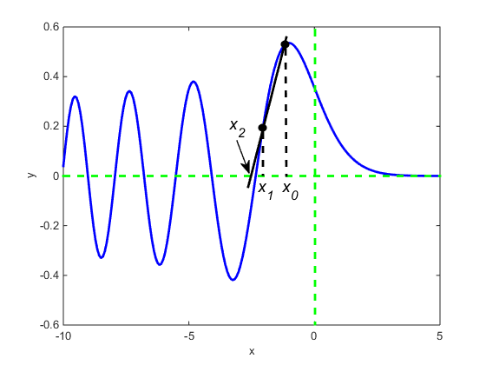
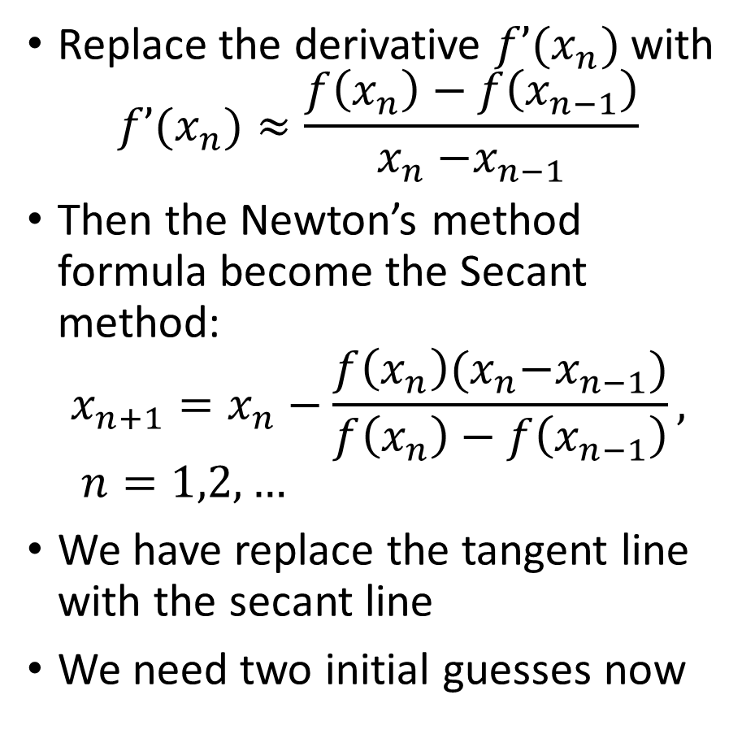
Root finding: Secant method
Replace the derivative $f’(x_{n})$with
$$f’(x_{n})≈\frac{f\left(x_{n}\right)−f\left(x_{n−1}\right)}{x_{n}{−x}_{n−1}}$$
Then the Newton’s method formula become the Secant method:
$$x_{n+1}=x_{n}−\frac{f\left(x_{n}\right)(x_{n}{−x}_{n−1})}{f\left(x_{n}\right)−f\left(x_{n−1}\right)}, n=1,2,…$$
We have replace the tangent line with the secant line
We need two initial guesses now

Slide 27
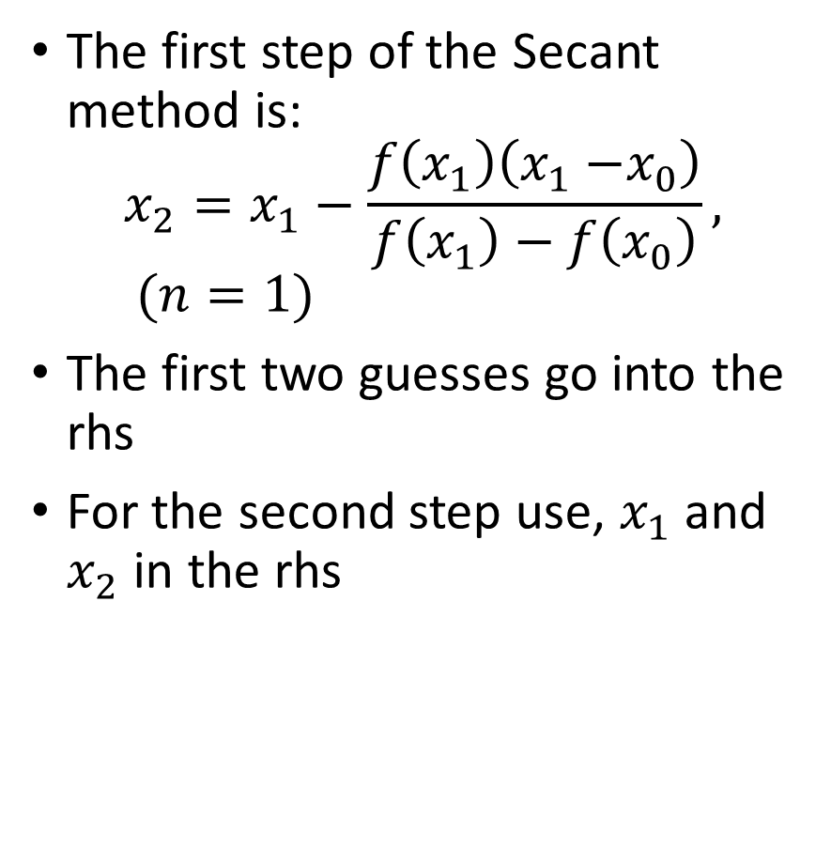
Root finding: Secant method
The first step of the Secant method is:
$$x_{2}=x_{1}−\frac{f\left(x_{1}\right)\left(x_{1}{−x}_{0}\right)}{f\left(x_{1}\right)−f\left(x_{0}\right)}, (n=1)$$
The first two guesses go into the rhs
For the second step use, $x_{1}$ and $x_{2}$ in the rhs

Slide 28
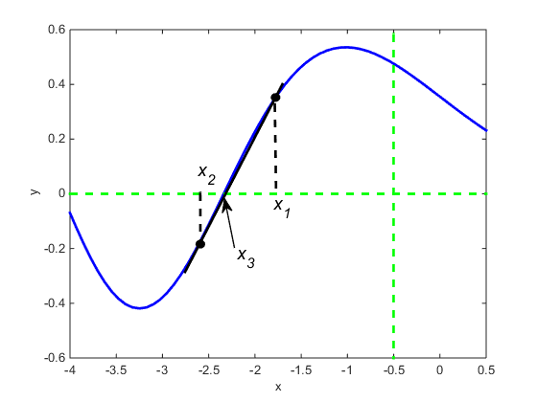
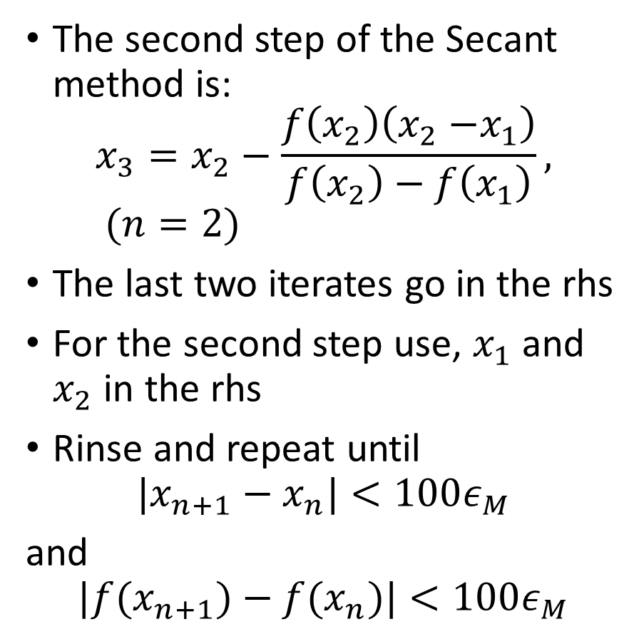
Root finding: Secant method
The second step of the Secant method is:
$$x_{3}=x_{2}−\frac{f\left(x_{2}\right)\left(x_{2}{−x}_{1}\right)}{f\left(x_{2}\right)−f\left(x_{1}\right)}, (n=2)$$
The last two iterates go in the rhs
For the second step use, $x_{1}$ and $x_{2}$ in the rhs
Rinse and repeat until
$$|x_{n+1}−x_{n}|<100ε_{M}$$
and
$$|f(x_{n+1})−f(x_{n})|<100ε_{M}$$

Slide 29
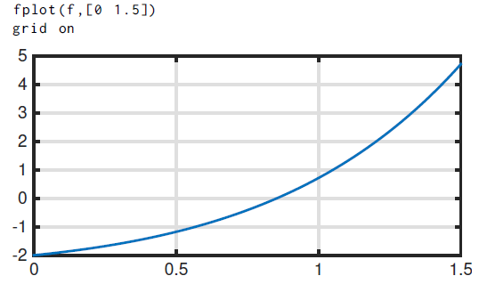

Secant method: example
Consider solving for $x$ where $2=xe^{x}$
We need to write it in standard form: $f\left(x\right)=xe^{x}−2$
Then we are solving $f\left(x\right)=0$
Define $f$ (only)
Use fzero to find “exact” answer
Plot:

Slide 30
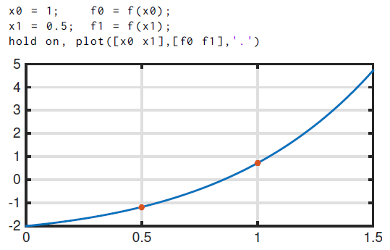


Secant method: example
Now compute function values at two guesses
Apply the formula to find where the line crosses y=0
Solve for next approximation:

Slide 31
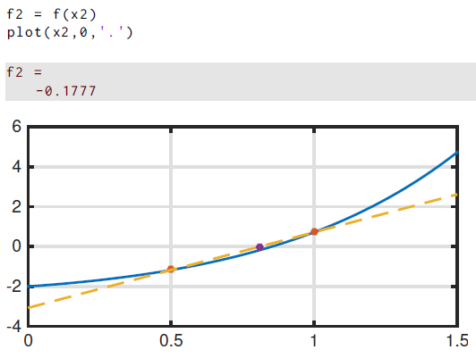
Secant method: example
No compute function values at two guesses
Apply the formula to find where the line crosses y=0
Solve for next approximation:
Plot:

Slide 32
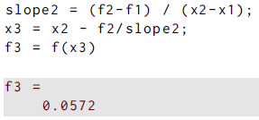
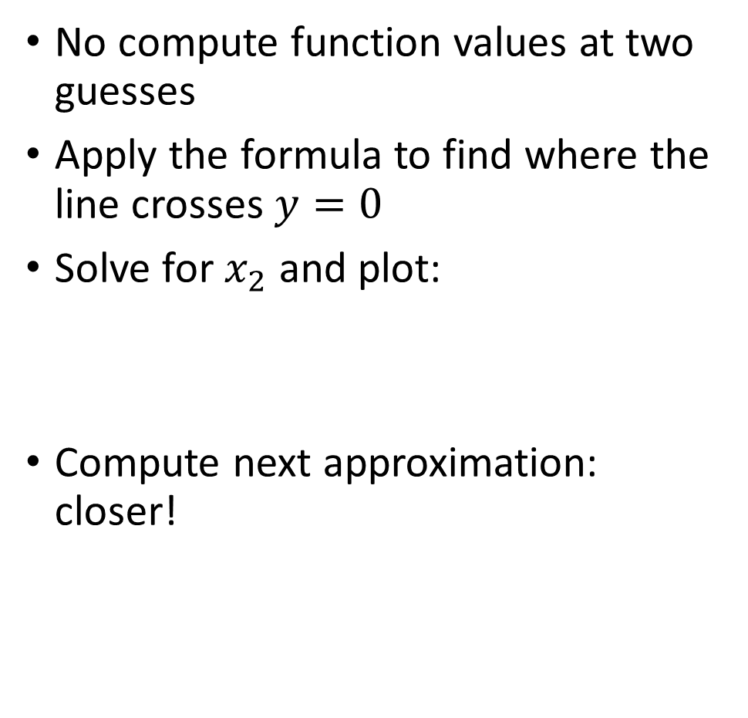
Secant method: example
No compute function values at two guesses
Apply the formula to find where the line crosses $y=0$
Solve for $x_{2}$ and plot:
Compute next approximation: closer!

Slide 33


Newton’s method: Code
For function, we need $f$, and two initial guesses
Tolerances in both $x$ and $f(x)$ are set to 100$ε_{M}$
A max number of iterations is set
Iterate in while loop until tolerances aren’t satisfied
Stops if too many iterations
Only red box is different than Newton function

Slide 34



Secant method: convergence analysis
Start out like Newton’s method, by creating equation for error
$$e_{k} = r−x_{k}$$
Taylor expand all the function evaluations to arrive at
Now assume a power dependence like we discussed before:
Substituting into the previous equation gives
This rate of convergence is superlinear but not as large as Newton
However, it can be less work for complex functions

Slide 35
Inverse interpolation: better than Secant?
The secant method used the previous to points to draw a secant line.
It can also be viewed as the linear interpolant to f(x) using the last two points.
One could reasonably ask what would happen if three points were used?
If we did this, we would have three points to determine three polynomial coefficients: this is a parabola.
We will study fast methods for this later, but for now, we can use Matlab’s builtin function polyfit
How to make the parabola?

Slide 36


Inverse interpolation: example
Again using :
$$f\left(x\right)=xe^{x}−2$$
Compute function values at three guesses near root
Now put a parabola through these three points, and find where it crosses y=0

Slide 37


Inverse interpolation: example
Say we call the parabola $P_{2}$, and we think we want $y=P_{2}\left(x\right)$
If we do, there could be 0, 1 or 2 roots, and this could be difficult to deal with
Better to use:
$$x=P_{2}\left(y\right)$$
Only a single crossing of y=0, and there is guaranteed to be only one
Use polyfit to create it and polyval to evaluate it

Slide 38


Inverse interpolation: example
It is easy to get the new root approximation from
$$x=P_{2}\left(y\right)$$
The single crossing just comes from plugging in $y=0$
It is just the constant term!
Then keep the new approximation:

Slide 39



Inverse interpolation: example
Now do a few more steps:
Error,
not quite quadratic: ratio not 2

Slide 40
Inverse interpolation: example
Error is not quadratic, but is still superlinear
This is still good. We have some work to get the coefficient of the polynomial, but we only need one more function value each step to get it
And, it is not much slower than either Newton or Secant

Slide 41
Return to fzero: how it works
Fzero uses a bracketing method for a few steps
Method of bisection finds an interval containing the root, and may narrow it
Then, inverse quadratic interpolation is used to converge to the root
This has the advantage of a slow but robust method (bisection) getting close to the root so the fast method (IQI) takes over
Let’s see details of fzero…

Slide 42

Return to fzero: how it works
Use $f(x)=xe^{x} −2$ bisection, then IQI

Slide 43

Return to fzero: how it works
Now set ‘Display’ to ‘iter’ to see details
Fzero makes an interval until a sign change found

Slide 44

Return to fzero: how it works
Endpoints where sign change happened plus initial point become three points for starting IQI
Then iterate using IQI

